Slide 1

Customizing Xamarin Forms Control using Effects
Kirk Patrick Junsay, Senior Expert Mobile Developer @ ERNI

Slide 2

About Me
Kirk Patrick Junsay
Senior Expert Mobile Developer @ ERNI
kirkpatrickjunsay@outlook.ph
Github: https://github.com/KirkPatrickJunsay
Blog: https://codesandchips.wordpress.com/

Slide 3



“
62% of users will uninstall an app that doesn’t work well
Even though mobile app revenue is forecast to be a whopping $189 billion in 2020, 60% of apps have never been downloaded. 57% of apps are deleted within 30 days.
21% of millennials will delete the app if they don’t like how it looks on their home screen
Nearly 73% of companies will conduct UX testing in the next 12 months

Slide 4


Slide 5
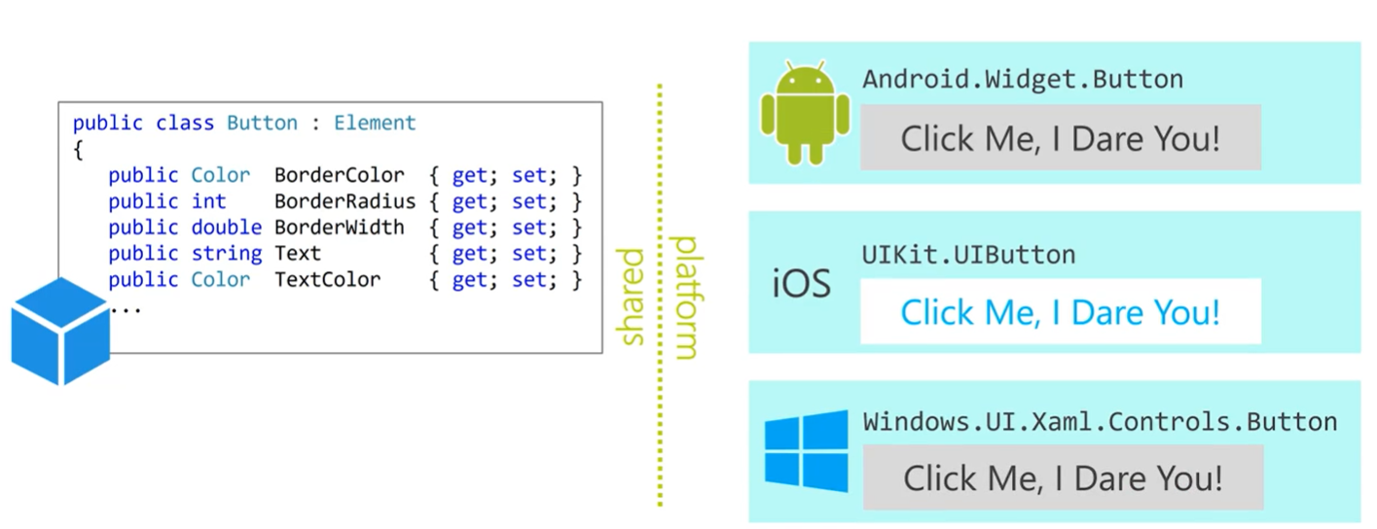
Xamarin Forms Control Rendering

Slide 6
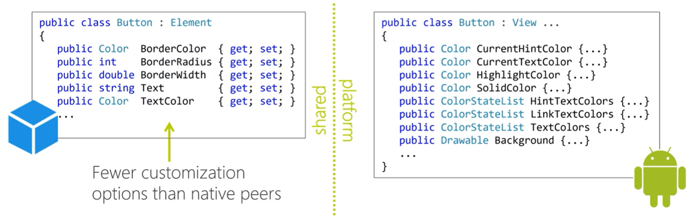
Limitations

Slide 7
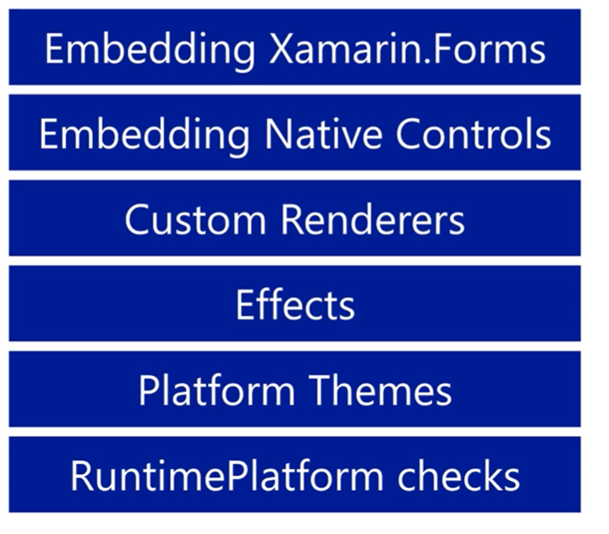
Xamarin Forms Customization

Slide 8
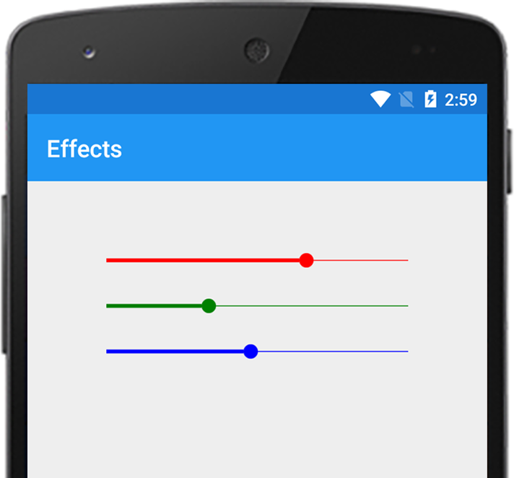
Why use an Effect?
Allows native controls to be customize.
Typically use for small styling change.
Lightweight compared to Custom Renderers.
You can add multiple effects on a control.
You can pass parameters on your effects.
You can define events.

Slide 9



What are the working components?
Container – References the platform-specific control being used to implement the layout.
Control – References the platform-specific control being used to implement the Xamarin Forms control.
Element – References the Xamarin Forms control that’s being rendered

Slide 10
DEMO TIME

Slide 11
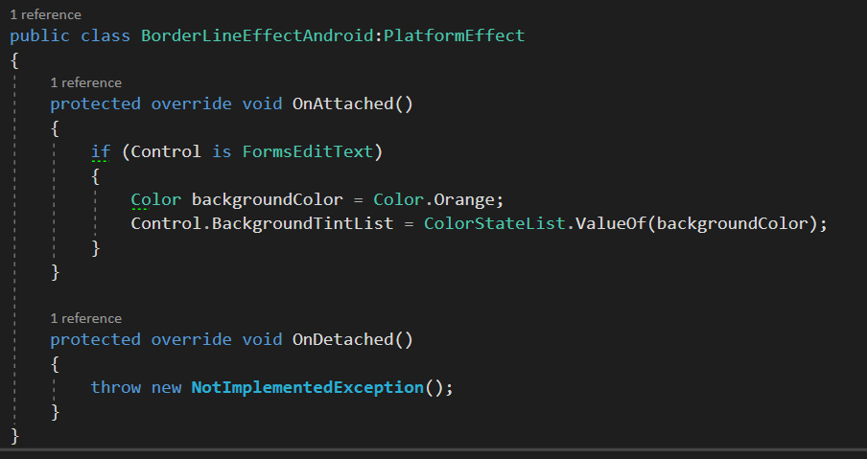
Step 1: Subclass PlatformEffect

Slide 12
Step 2: Override OnAttached and OnDetached method

Slide 13
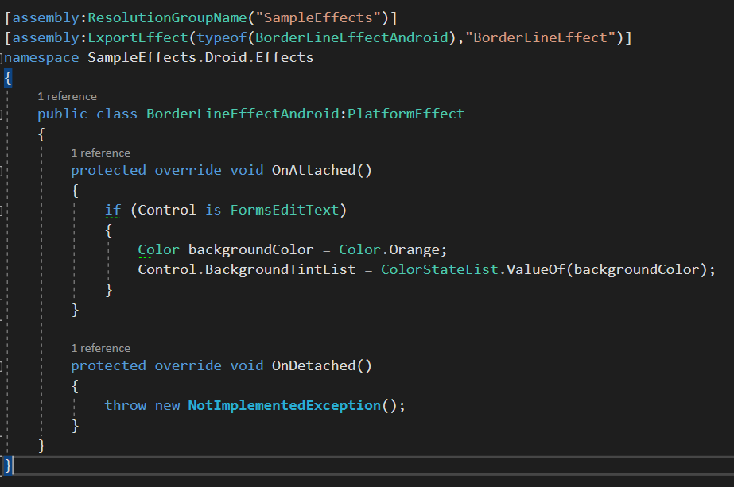
Step 3: Add a Resolution Group Name

Slide 14
Step 4: Add an Export Effect

Slide 15
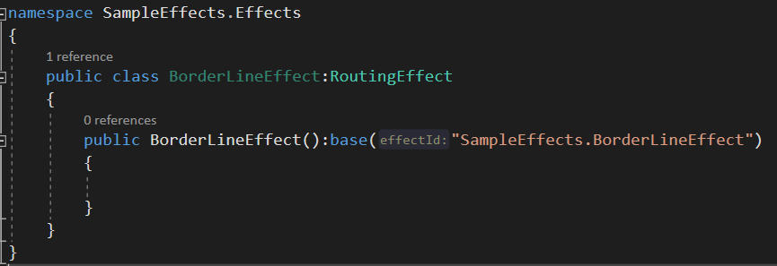
Step 5: Subclass Routing Effect

Slide 16
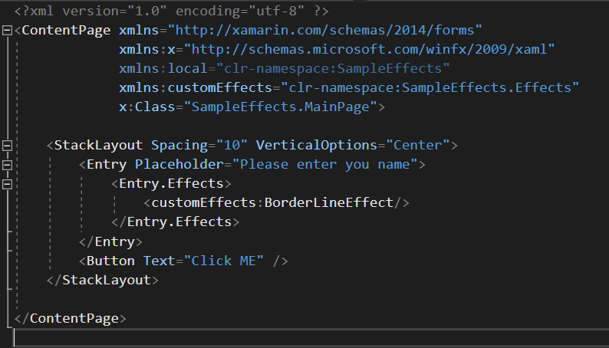
Step 6: Attached on Xaml Control

Slide 17
Sources
https://docs.microsoft.com/en-us/xamarin/xamarin-forms/app-fundamentals/effects/

Slide 18
Thank you!
Shoot your Questions!
Kirk Patrick Junsay, Senior Expert Mobile @ ERNI

